Slide 1
Information Webinar Community Participatory Action Research Cohort 2 Programme
Joanne McEwan
Public Health Development Manager (Thames Valley)
HEE South East

Slide 2
Why Community Participatory Action Research?
What we did
Trained and mentored 35 community researchers in SE
Thinking and working differently
in response to a national document
working directly with community organisations delivering training and mentoring on how to do community research
co-productive training and mentoring on community participatory action research where communities set the agenda on health needs and the research required
community researchers linked with strategic partners to enable the outcomes of research
Commissioned Scottish Community Development Centre delivered training and mentoring
“supporting community participatory research, in which researchers and community stakeholders engage as equal partners”.

Slide 3
Key principles of project
Valuing the researchers’ worth - Payments for researchers – valued, not another volunteer workforce
Co-production from the start – developing recruitment processes, training programme
Collaboration - broad membership of steering group
Community led – freedom to choose their research/set priorities
Inclusion – recruitment of those genuinely connected to communities, inclusion specialist on panel, ensuring representation at all levels.
Learning from the communities – acknowledging we are not the experts, flexible and accommodating

Slide 4
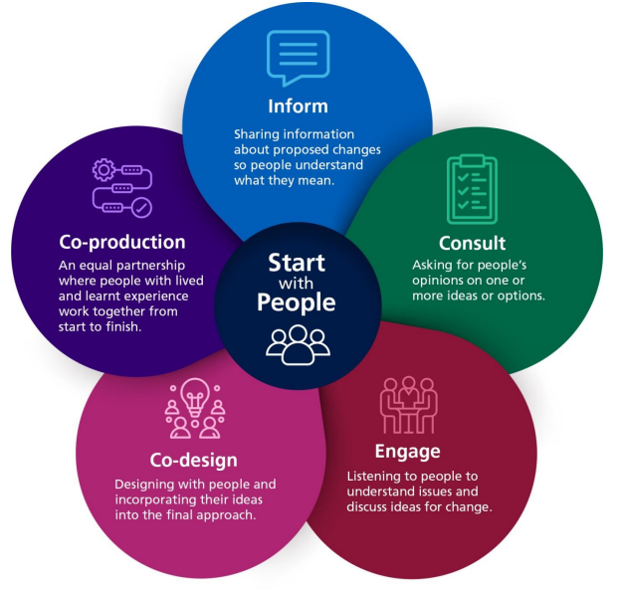
Why is this important?
Address health inequalities at the source
As the focus will be the cost-of-living crisis for marginalised communities, the programme will adopt the following policy levers: incorporating an Equality delivery system and working in partnership with communities.

Slide 5
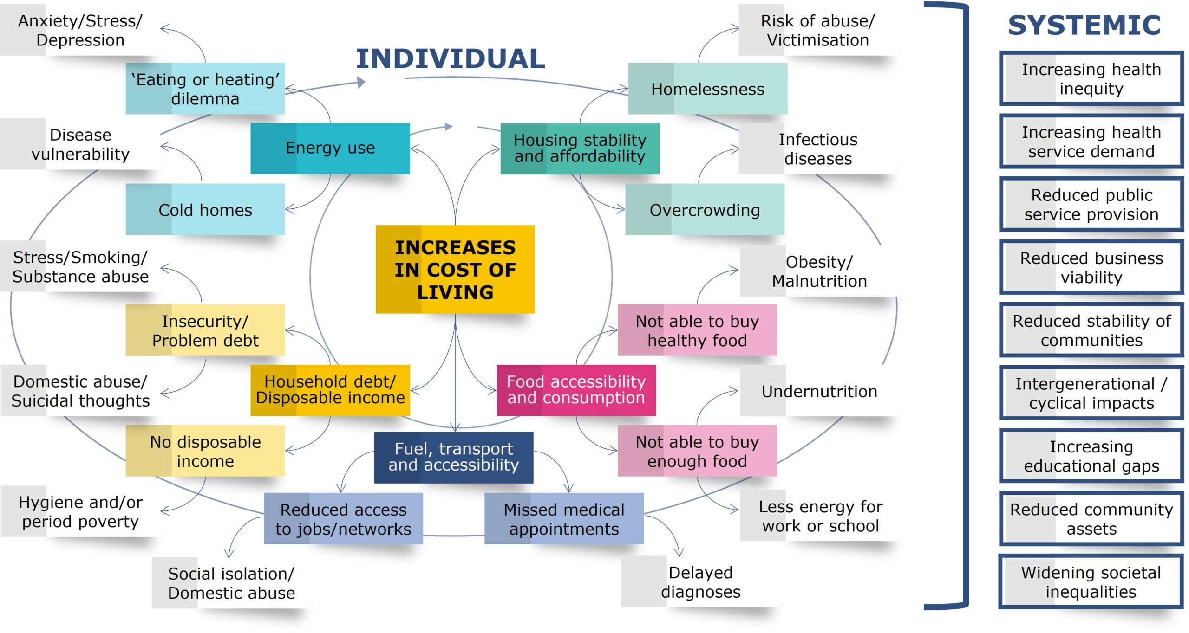
CPAR 2 Programme
What is the focus?
Cost of living crisis
Health inequalities
Who will it affect?
Marginalised communities in the South East
What will it impact?
Support health and care leaders in shaping their priorities and service for marginalised communities.
Image from: www.iwa.wales/agenda/2023/02/taking-a-public-health-approach-to-the-cost-of-living-crisis/

Slide 6
CPAR Programme Offer
Training and mentoring for community researchers
Funding to pay Community Researchers:
up to 15 hours per week for 12 months
Up to 3 researchers per organisation
Support to host organisations
Enabling strategic links for action
Host organisation forum – listen and make changes as necessary
Researchers network – support networking
CPAR Showcase

Slide 7
David Allan Scottish Community Development Centre

Slide 8
Applying to CPAR 2
Completing the application
Not an academic research - not looking for jargon, or theories
Who can apply?
Genuinely connected with communities
Role of the host organisation
Managing payments
Recruiting researchers
Technology and equipment
Supporting your researchers

Slide 9
Selection Process
Recruitment panel
Criteria for selection
Working with marginalised communities where health inequalities are experienced as a result of the cost of living crisis
Strong and enduring relationship with the communities affected
Organisation support and logistics
Fits with organisation aims, objectives and values

Slide 10
Dr Ester Oenga University of Reading

Slide 11
Application timeline
Applications open | 13 March 2023
CPAR Webinar | 20 March, 12:00 - 13:00
CPAR Q&A drop-in sessions | 28 March, 12:00 - 13:00
 | 5 April, 12:00 - 13:00
Applications close | 13 April 2023 noon
Panel approval & applicants informed of outcome | 20 April 2023
Training &Mentoring programme starting date (detailed training dates to be confirmed, see appendix 2) | Week commencing 22 May 2023
Research projects completed | 10 May 2024
Showcase event | 24 - 28 June 2024

Slide 12
Q&A

Slide 13
Important links
HEE website
Dedicated page which includes CPAR evaluation from cohort 1
Contact: PublicHealthSchools.SE@hee.nhs.uk

