Slide 1
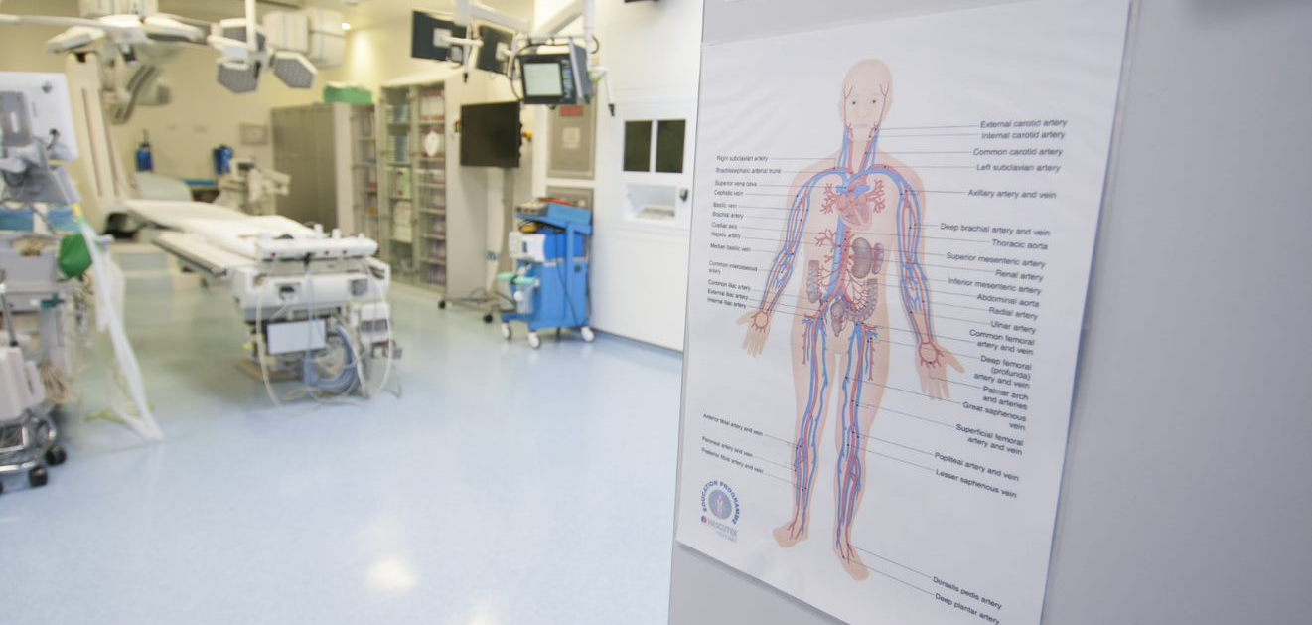
Supporting and escalating concerns
HEE Supporting and Escalating Concerns Pathway

Slide 2
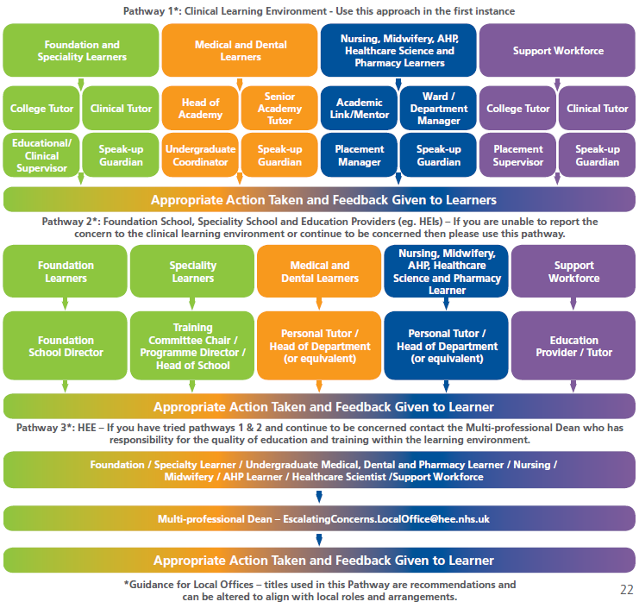
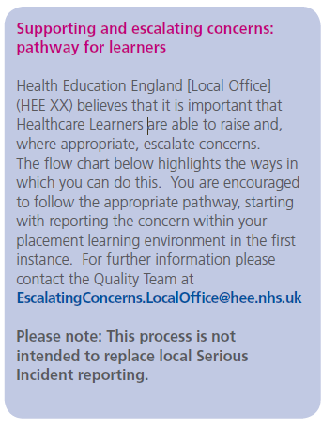
HEE Supporting and Escalating Concerns Pathway

