Slide 1
Duties of a Dr/GMC/Professionalism
How to interpret and use GMP 24
Presented by: Dr Manjiri Bodhe HoS
Dr Shareen Hallas Deputy HoS
Notes:
Standard title slide

Slide 2
New Duties of a doctor/Good medical practice
Good medical practice 2024 - GMC (gmc-uk.org)
Some changes to this
Sexual misconduct
Social media guidance
The updated professional standards have a stronger focus on behaviours and values which create respectful, fair and supportive workplaces.
Notes:
Plain slide with subhead and bullets

Slide 3
New Duties of a doctor/Good medical practice
Good medical practice 2024 - GMC (gmc-uk.org), some specific areas updated
Delegation and referral
Ending your professional relationship with a patient
Identifying and managing conflicts of interest
Intimate examinations and chaperones
Maintaining personal and professional boundaries
As the themes and issues are strongly related, we’ve combined Maintaining a professional boundary between you and your patient with the guidance on Sexual behaviour and your duty to report a colleague. This means Sexual behaviour and your duty to report a colleague won’t be a standalone guidance document from 30 January 2024.
Providing witness statements or expert evidence as part of legal proceedings
Using social media as a medical professional
Notes:
Plain slide with subhead and bullets

Slide 4
New Duties of a doctor/Good medical practice
Good medical practice 2024 - GMC (gmc-uk.org)
We will focus on 2 cases
Essentially do a Q and A so can see what your ideas are
Go through in detail possible outcomes
Notes:
Plain slide with subhead and bullets

Slide 5
Social media use
What do we need to be aware of in this case?
Dr A is a GP trainee ST2 in a training programme.
Dr A does 80% LTFT training. In his spare time he has a tik tok social account called DR A makes health simple and posts information around good health and lifestyle advice on his Tiktok account. His account bio includes GP and doctor.
As part of this he has a paid partnership with a brand that sells protein shakes and in addition also gives advice around weight loss .
Questions- what does DR A have to be aware of in relation to social media usage as Dr? what are his responsibilities as a trainee? What does he need to disclose ?

Slide 6
GMC GMP 24
Maintaining public trust
7.How you behave when using social media matters. Medical professionals, like everyone else, have rights to freedom of belief, privacy, and expression. But exercising these rights when using social media as a medical professional has to be balanced with the possible impact on other people’s rights and interests.
8.It is important that your content includes appropriate context, so that people who access what you say about health and healthcare have information that supports their understanding and helps them to verify your claims and expertise. If you’re commenting on health or healthcare issues you should usually say who you are.
9.Bear in mind that content uploaded anonymously can, in many cases, be traced back to its point of origin. When communicating privately, including using instant messaging services, messages or other communications in private groups may also become public. We have a legal duty to investigate any concerns raised to us that reach our fitness to practise threshold.

Slide 7
GMC –being honest and trustworthy In your communications
11.You must take reasonable steps to make sure that the information you communicate on social media as a medical professional is not false or misleading and does not exploit people’s vulnerability or lack of medical knowledge. You must not misrepresent your experience and qualifications.
12.If you use social media to advertise your services, or use your professional position to promote or endorse any other services or products, you must be open and honest about any interests you have that may influence (or could be seen to influence) the recommendations you make. You must also comply with relevant law, guidance and regulatory codes including those from the Committee of Advertising Practice, the Advertising Standards Authority and the Competition and Markets Authority.
13. Where relevant you must also follow the more detailed guidance we publish. In particular:
Identifying and managing conflicts of interest
Guidance for doctors who offer cosmetic interventions
Good practice in prescribing and managing medicines and devices.

Slide 8
Case 2.
Dr Z is a GP trainee working in a GP partnership for a 6 month placement. They have been asked to see a patient of the opposite gender for a hip examination and whilst there the patient also complains of a chesty cough they would like the Dr to check.
What points would you like to flag up pre examination- what do you as a dr need to do to ensure a safe consultation?

Slide 9
Intimate examinations
5.Intimate examinations are likely to include examinations of breasts, genitalia and rectum, but could also include any examination where it is necessary to touch, examine intimate parts of the patient’s body digitally, or even be close to the patient. Some patients may have particular concerns about undressing or exposing parts of their body but feel hesitant to speak up.
Before the examination:
7.Whenever you examine a patient, you should be sensitive to what they may think of as intimate and make clear the steps that will be carried out as part of the examination, before it begins.
8.Before conducting an intimate examination, you should:
explain to the patient why an examination is necessary and give the patient an opportunity to ask questions
consider and address any communication barriers that could impact on the patient’s experience or understanding of an intimate examination
explain what the examination will involve in a way the patient can understand, so that they have a clear idea of what to expect, including any pain or discomfort
explain to the patient that they can ask at any time for the examination to stop
offer the patient a chaperone (see paragraphs 16– 22) and explain what the chaperone’s role would be during the examination.

Slide 10
Intimate examinations contd.
16When you carry out an intimate examination, you should, wherever possible, offer the patient the option of having a chaperone who can act as an impartial observer. You should explain what the chaperone’s role would be during the examination.
20A relative or friend of the patient is not a trained impartial observer and so would not usually be a suitable chaperone. However, the presence of a chaperone does not override a patient’s wish to be supported by a relative, friend or advocate. You should comply with a reasonable request from the patient to have such a person present as well as a chaperone.
22If you wish to examine the patient with a chaperone present but the patient has said no to having one, you must explain clearly why you want a chaperone present. If the patient wishes to proceed without a chaperone but you remain uncomfortable with this, you may wish to consider referring the patient to a colleague who would be willing to examine them without a chaperone, as long as the delay would not adversely affect the patient’s health. If you feel your personal safety is at risk you should follow the guidance in Maintaining personal and professional boundaries or Ending a professional relationship with a patient.
23You should record the detail and outcome of any discussion about chaperones in the patient’s medical record. If a chaperone is present during an examination, you should record that fact and make a note of their identity and role. If the patient does not want a chaperone, you should record that the offer was made and declined.

Slide 11
New area of GMP-
Contributing to a positive working and training environment
56.You must not abuse, discriminate against, bully, or harass anyone based on their personal characteristics, or for any other reason. By ‘personal characteristics’ we mean someone’s appearance, lifestyle, culture, their social or economic status, or any of the characteristics protected by legislation – age, disability, gender reassignment, race, marriage and civil partnership, pregnancy and maternity, religion or belief, sex and sexual orientation.
57. You must not act in a sexual way towards colleagues with the effect or purpose of causing offence, embarrassment, humiliation or distress. What we mean by acting ‘in a sexual way’ can include – but isn’t limited to – verbal or written comments, displaying or sharing images, as well as unwelcome physical contact. You must follow our more detailed guidance on Maintaining personal and professional boundaries.
58. If you witness any of the behaviours described in paragraphs 56 or 57 you should act, taking account of the specific circumstances

Slide 12
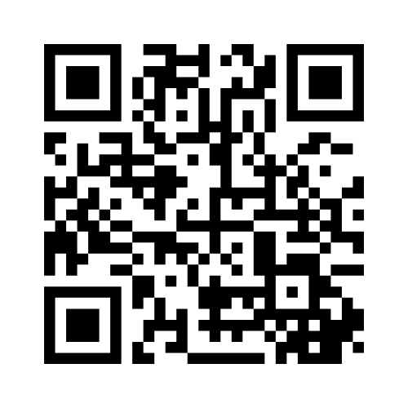
Good Medical practice

Slide 13
https://www.mentimeter.com/app/presentation/n/albsew8nsbrociu6z8vrasz1fu3bi2qz/present

