Slide 1
SIMULATOR - AN EDUCATIONAL TOOL

Slide 2
In this session you will learn..
Why learn with simulator?
Where is the simulator?
What do you need to if it is your first time using the simulator?
What you must do on the day you come into scan?
Safety measurements
Videos

Slide 4
Why learn with Simulator?
Real patient scans: replicate what a full anatomy would see on a real ultrasound
Probe manipulation skills module Helps trainees manipulate probe and develop hand-eye coordination
Virtual tutor: learning with an expert in the room
Remote learning
Real-time assessment
Notes:
To train in uss
Patient
-machine
tutor

Slide 5
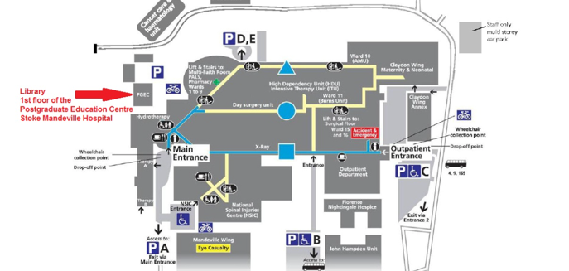
Where is the simulator?
1st floor of the Duke of Edinburgh Hall Building, Postgraduate Centre at Stoke Mandeville Hospital.
The Training Room Number 3 (last door on the right-hand side)

Slide 6
What do you need to if it is your first time using the simulator?
Contact Ultrasound Sim Rep: Saba.fatima79@yahoo.com
Book a slot:
This email is checked from Monday to Friday once a day by the Postgraduate team.
Auditing: even if it’s a weekend!
Avoid double booking & disappointment.
It will be a first come, first served basis

Slide 7
What you must do on the day you come into scan?
The room and the centre are open:
Monday to Friday from 0730-17.30 and they are closed during the weekends.
If your slot is during their working hours: the team will allow you in up to the room;
If your slot is out of hours: you will need a pass to open the outside door (it will be left in the main building - security with your name on it).
On the day, please fill the check in form: to record attendance and use of the simulators.
Notes:
Currently we are not asking for any payment from doctors outside of the trust, but please understand that this situation may change particularly if people book slots and don’t attend them.

Slide 8
Covid-19 and safety measurements
Use the hand sanitiser gel before starting to use the machine (on the table near the simulator).
Maximum number of people training is 2
Do not eat or drink while using the simulator.
Clean the handle of the probes with clinell after finishing your session.
Leave the room as you found it.

Slide 9
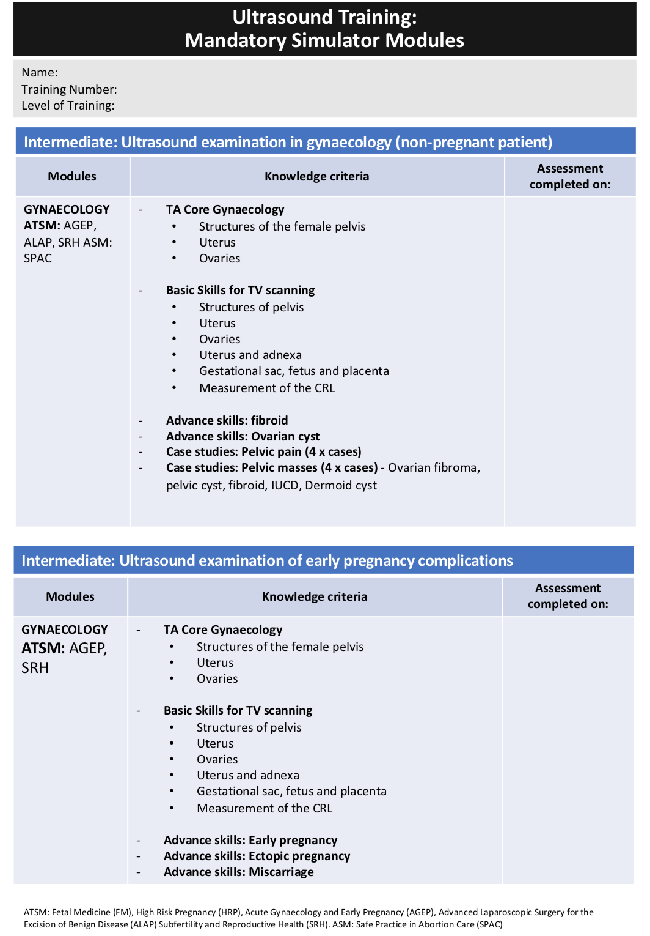

Slide 10
Videos
The hardware - ScanTrainer v 2016 https://youtu.be/pVRQIXTzVlU
Logging into ScanTrainer - v 2016 https://youtu.be/4mEgV675dXU
Launching an assignment - ScanTrainer v 2016 https://youtu.be/L9hS-7C76ho
Taking an assignment - ScanTrainer v 2016 https://youtu.be/Sz0exzkL1XQ
Assignment results - ScanTrainer v 2016 https://youtu.be/HvKk2OO2yCg
Shutting down ScanTrainer - v 2016 https://youtu.be/H8-ch9mrmxk

Slide 11
Thank you! Please let the USS trainee Reps know if you need any help. Saba.fatima79@yahoo.com

Slide 12
Bodyworks Eve Simulator at Royal Berkshire Hospital (just for RBH trainees)
Has few early pregnancy scenarios
Ectopic Pregnancy Left Adnexa
Ruptured Ectopic Pregnancy Left Adnexa
Ectopic Pregnancy Right Adnexa
Ruptured Ectopic Pregnancy Right Adnexa
Early Pregnancy, No Gestational Sac
IUP - 6 Weeks
Large Pelvic Mass
Small Pelvic Mass
IUP - 11 Weeks

Slide 13
To book
Simply use the link below from either your phone or a computer and you should be able to book a slot.
https://calendly.com/simlabroom2/60min

